Slide 1
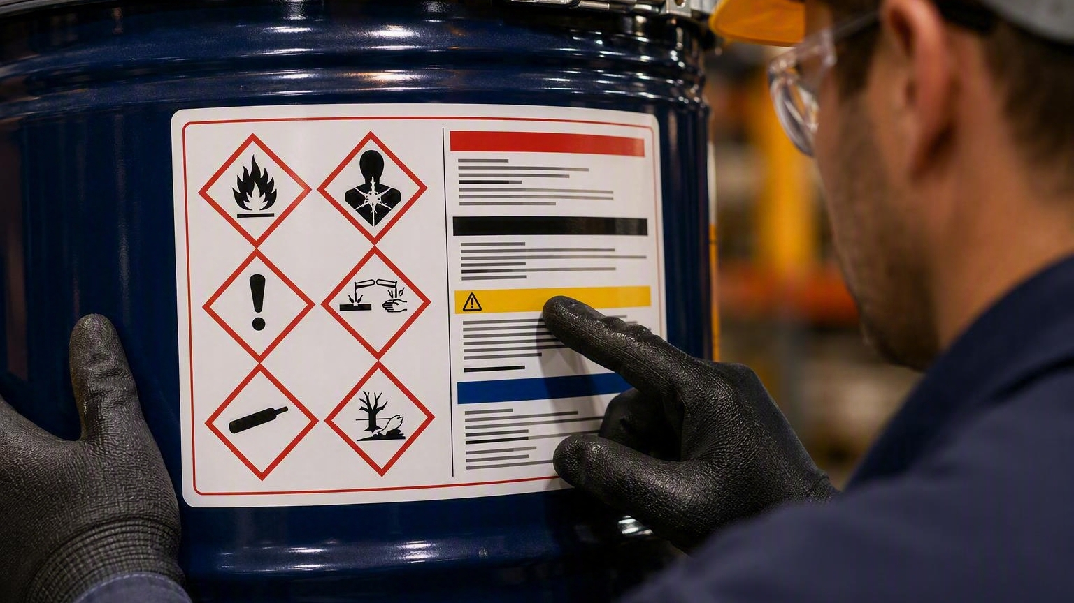
HAZARD
COMMUNICATION
More Than Labels and Safety Data Sheets
Information for better decisions before exposure
Black Swamp Safety Council
Notes:
Hazard communication is basic blocking and tackling to make sure workers right to know and right to understand are met. The reason to do it isn’t just because OSHA says so- it’s because better information leads to better decisions in the moment. Ensuring your program elements are in place- Chemical Inventory, Labels, SDS, Training, and having a program that coordinates it will lead to better performance where chemicals are involved.

Slide 2
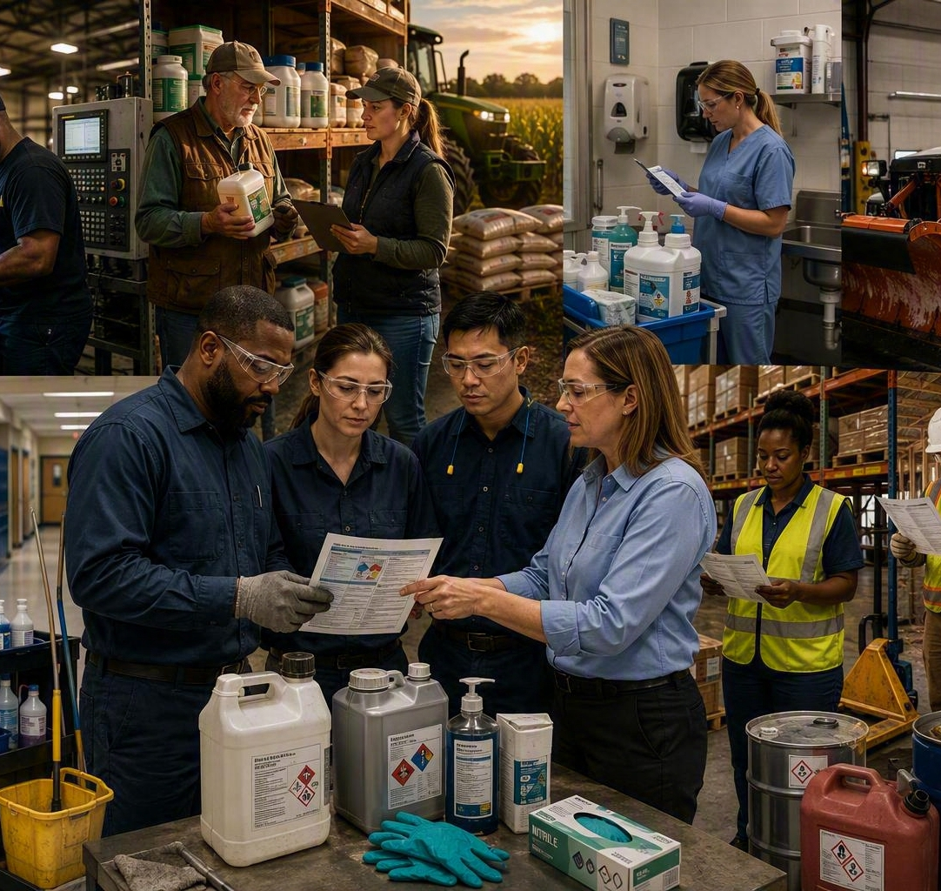
When does a chemical incident actually begin?
Opening discussion
Before contact.
The exposure is often the last step in a longer chain of decisions.
Hazard not recognized
Information not available
Risk not communicated
Decision made without context
Notes:
Many times a chemical incident begins long before the event that has to be reported and responded to. A chemical wasn’t evaluated for hazards before being purchased, information isn’t readily available when needed and people make decisions in the absence of information, a label wasn’t put on a container to communicate the risk of the contents- All decisions are made better with context as opposed to without context. This is the basis of good chemical safety- making sure our teams are trained to use the information available and ensuring the information is accessible.
Story- Hazard not recognized (cleaning up the shop and storing flammable chemicals in a room with an ignition source neatly)
Story- 1st job exposure, risk not communicated, no gloves used, defatting rust preventative oil

Slide 3

Why Hazard Communication Exists
RIGHT TO KNOW
RIGHT TO UNDERSTAND
Workers need the identity, hazards and protective measures for a chemical before they decide how to use it.
OSHA 29 CFR 1910.1200(a): classify hazards and transmit information through a comprehensive program.
Notes:
CORE MESSAGE: Hazard Communication is an information system built around decisions, not a binder built around documents.,OSHA requires chemical hazards to be classified and the information transmitted through labels, safety data sheets, and training. GHS gives that communication a more consistent structure.,The practical question is not whether information technically exists. The practical question is whether the person doing the work can find it, understand it, and act on it before exposure.,TRANSITION: Employees experience the system through four basic questions
Workers have both a Right to Know and a Right to Understand the chemicals they work with. The right to know is making sure we have labels and corresponding SDS sheets for our chemical inventory. The right to understand is making sure we have trained our people to understand and react to the information available on a specific chemical they have to work with. Both concepts are important to ensure we meet our requirement to provide a safe and healthful workplace for our employees. Employees who can’t identify chemicals, don’t have source material to educate themselves with, and that lack basic training will make worse decisions with chemicals.

Slide 4
The Four Questions Every Employee Needs Answered
Employee Question | Hazard Communication Program Element
What chemicals do we have? | Chemical Inventory
What is this? | Labels
What do I need to know? | Safety Data Sheets
What should I do? | Training
Employee Question
Hazard Communication Program Element
Notes:
This table covers the basic questions we have to answer for our teams when chemical safety is involved.
They need to know what chemicals we have onsite- and specifically they should be trained on the more hazardous chemicals in the inventory if there are some. The depth of training should reflect the chemicals and exposures in the workplace. A healthcare operation may spend more time on disinfectants and sterilants. A municipality may emphasize treatment chemicals and fuels. A fabrication business may focus on coatings, solvents, and welding-related products. The inventory tells us where additional attention is needed. At a minimum they need to know what is in the container they are looking at and without a good labeling program that is difficult to ensure. Even if they can identify the chemical- that information isn’t as useful without and SDS to research the chemical with. Arguably most important is training- how to make and read labels, where to find SDS sheets, basic chemical safety measures like PPE, distance, and exposure time controls. If your program answers these questions for your employees then you are well on your way to having a functional chemical safety program.

Slide 5
The Written Program Coordinates the System
Inventory
Labels
SDSs
Training
Ownership • methods • access • maintenance • coordination
A binder can document the program. It cannot run the program.
Notes:
OSHA requires employers to develop, implement, and maintain a written Hazard Communication program. The practical purpose is coordination. The program should explain how the organization maintains its chemical list, labels workplace containers, provides SDS access, trains employees, and exchanges information with other employers. If those activities operate separately with no ownership or change process, the organization may possess the documents without having a reliable program

Slide 6
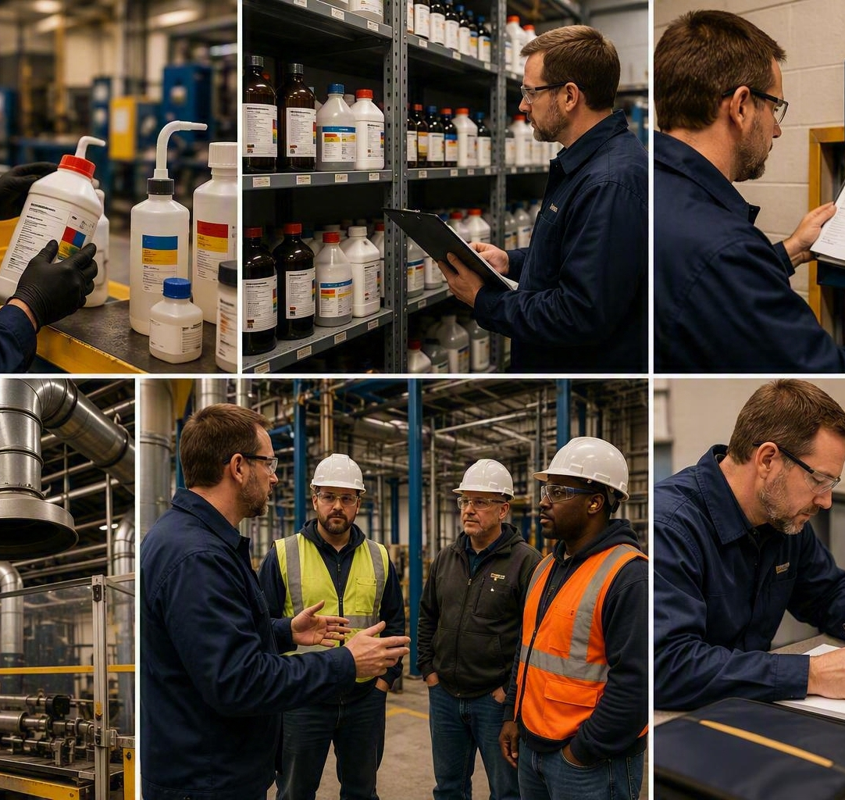
1. Chemical Inventory
A management map of what is actually present
If the list does not match the workplace, the rest of the system cannot be trusted.
Walk the workplace
Match product identifiers
Find orphaned and obsolete products
Use the list to track SDSs, labels and training
Notes:
The chemical inventory is the list of chemicals present in the workplace; we should know what chemicals we have on site. Making the inventory list is a simple process of walking the plant writing down the list of chemicals you find. Then ask yourself if all those chemicals are actively used, needed, and has a corresponding SDS in the right location. For chemicals on site without an SDS you can fix it by acquiring an SDS sheet, for chemicals on site that you don’t use anymore you can dispose of the chemical to reduce risk and inventory. Use the list to compare to your training offered- are you offering the right amount of training for the level of chemical hazards in your work space? Use the exercise of creating or verifying your inventory, which you should do at least annually, to check how well your labeling is applied to secondary containers. OSHA does not give us an annual inventory date or requirement. Annual verification is a practical minimum for many workplaces, but higher-change operations may need more frequent reconciliation.

Slide 7

2. Labels
The fast answer at the container
A label should let the user recognize the product, the hazard and the immediate precautions.
IDENTITY
HAZARD
PRECAUTIONS
Management question: Can employees understand the label under real working conditions?
Notes:
Labels communicate the contents of a container. Manufacturers are responsible for properly labeling the container in which a chemical is sold on the market. We are responsible for labeling every additional container of that chemical we create. Labels have come a long way since the 90’s. It isn’t just a name and a few numbers. To meet the requirements of GHS every container requires the identity (name) of the chemical, the signal word for the chemical (Caution / Danger), the hazard statements, the precautionary statement, the supplier information, and any associated Pictograms. That makes the labels far more useful today then they were back then, but it also makes them more difficult to create legibly. I think label creation is one of the best drivers of a digitized service to manage SDS’s because those typically have functionality to create a proper label for any chemical SDS stored in the software.

Slide 8

Secondary Containers
The hazard does not disappear when the product moves
Would a different employee know what is in this container and how to handle it?
Container identity and hazard information must survive the transfer.
Notes:
Secondary containers are any container that you use to store a chemical in other than the one the manufacturer sold it in. In all cases a secondary container must be labeled with the Signal Word, the Product Identifier, the Precautionary Statements, the Hazard Statements, the supplier information, and any pictograms required by the chemical. The goal of labeling secondary containers is to give workers the ability to identify the contents of the container and how to handle it properly. Without labels workers would not be able to prepare to safely work with a chemical because they won’t know what the chemical is.
Depending on pace- story- spilled caustic solution from unmarked bucket, chemical incident x2 (Spill and Exposure first aid), bad spill response + bad labeling = 2 chemical incidents

Slide 9
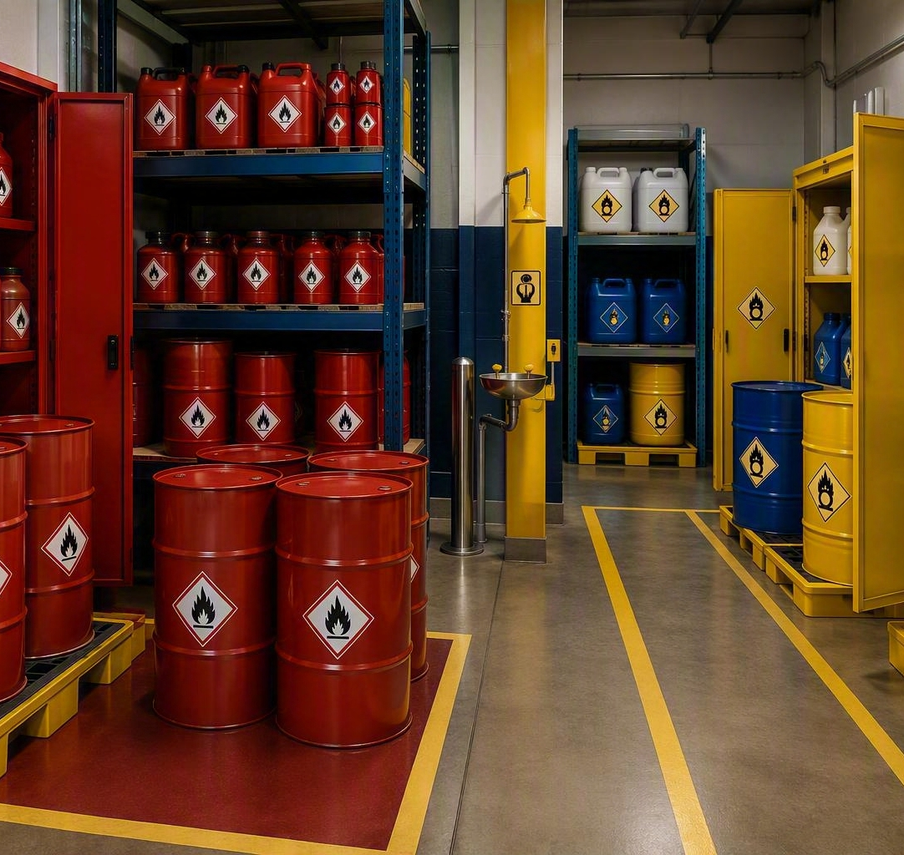
3. Safety Data Sheets
Depth when the label is not enough
The SDS is a decision tool, not a filing requirement.
2
Hazards
4
First aid
6
Spill response
7
Handling & storage
8
Controls & PPE
10
Stability & reactivity
Notes:
Safety data sheets are the source of information for chemicals for our workers. They contain a set number of sections that each contain specific information. The entire SDS doesn’t have to be memorized for a chemical in order to be effectively informing our workers- we can teach them where the most relevant information is for them in the document. Sections 2, 4, 6, 7, 8, and 10 are important to workers because they contain the information that is critical for them to understand on the chemical. You should have an SDS sheet for every chemical that is on site. Putting them in a giant, unorganized binder is a surefire way to ensure that they aren’t referenced or used by your employees. Putting effort into the organization of this source material is an important step in chemical safety and my position is that electronic management of SDS sheets is the most effective. Not only do you get the support of label creation but employees can search your chemical inventory like google which makes it easy for workers to use effectively.

Slide 10
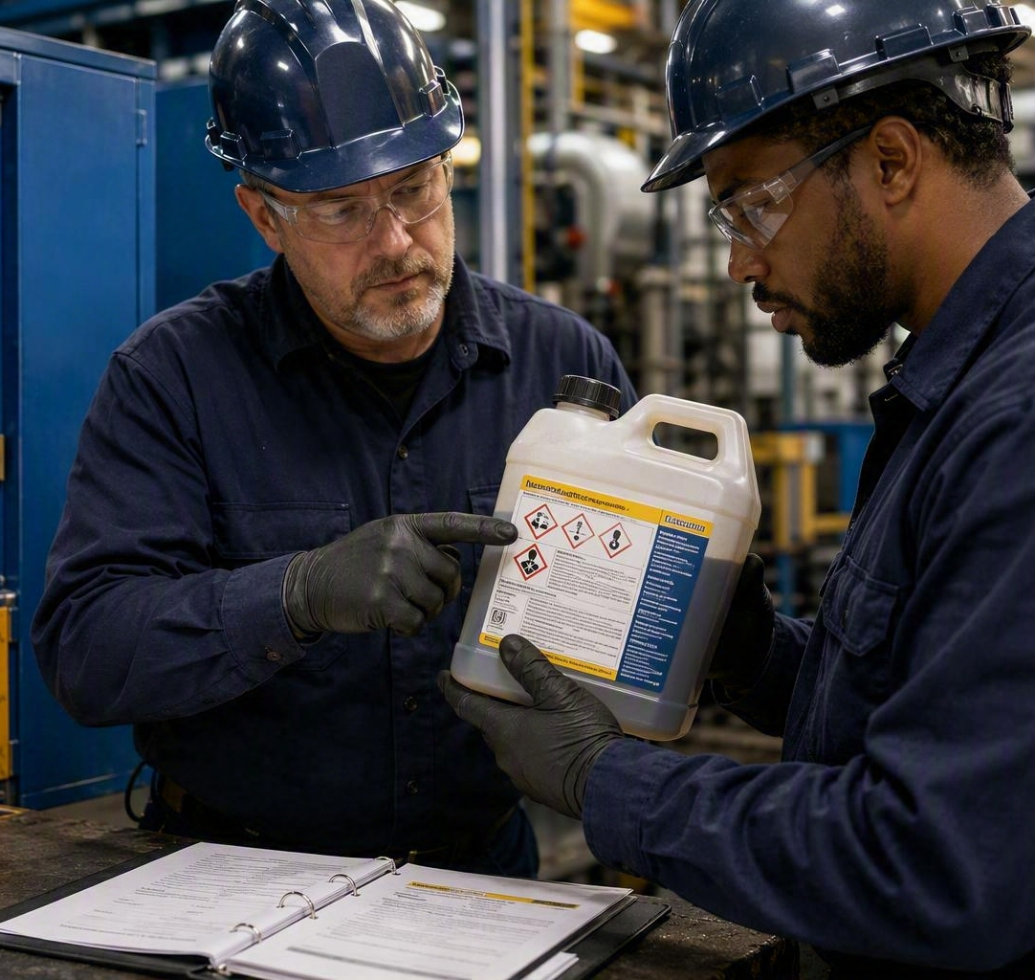
4. Training
The point where information becomes a safe decision
Good training prepares people for the chemicals and tasks they will actually encounter.
Recognition → Access → Action
Can the employee explain what they would do before opening, mixing, transferring, cleaning or responding?
Notes:
Training of your workers is a critical step in chemical safety. Ensuring they understand how to read and create labels, giving them some training on where the SDS sheets are, how to access them, and what information is stored in and SDS sheet, giving them the basics of chemical safety like PPE, Distance, and Exposure time control will round out the education on your program. An employee should be able to explain what chemicals they work with, how to keep themselves safe while working with them, and what to do with any waste material left over or respond to a spill of the material.
Talk about thinking through at a minimum the chemicals used in standard work processes and developing some basic training around those chemicals and the best practices on how to work with them.

Slide 11

Chemical Storage
Organize by hazard, not convenience
Storage is a decision about compatibility, containment, conditions and access.
Compatibility
Secondary containment
Temperature and ventilation
Ignition control
Emergency access
Notes:
Chemical storage is more than just what shelf is empty when you buy the chemical.
In order to make your work space as safe as possible thinking through items like compatibility, where you have secondary containment, the temperature and ventilation of the storage area, and emergency access to the location.
Where flammable chemicals are concerned understanding your ignition controls in the storage area is important as well.
If you spend time organizing your chemicals into a system that makes sense in your workplace, you create an environment where working with chemicals is safer by nature because there was forethought and planning about where and how to store them before use ever becomes a need.

Slide 12
A Common Compatibility Question
FLAMMABLES
OXIDIZERS
fuel for fire
can intensify combustion
DO NOT STORE BY APPEARANCE
Use the label and SDS to identify incompatibilities and storage conditions.
Notes:
You don’t have to be a chemist to know what chemicals can be stored with other chemicals- you just need to read the SDS. SDS sheets will list incompatible chemicals in section 10, but it will list storage recommendations / requirements in section 7. Making sure that you follow these instructions can be summarized with the example on the slide- you don’t want to store the fuel for a fire next to the item that will intensify the combustion process if it ignites. So you always want to store your flammables separate from your oxidizers. You can’t tell what chemicals should be stored with what chemicals or in what locations simply by looking at the packaging or seeing “where it fits” in the gear locker- being intentional with your chemical inventory storage will set your employees up for success.

Slide 13
Controls Should Change the Exposure
SDS’s tell us what to control. Management decides how.
ELIMINATE
Do we need it?
SUBSTITUTE
Is there a safer option?
ENGINEER
Can we contain or capture it?
ADMINISTER
Can we improve the method?
PROTECT
What PPE remains necessary?
Notes:
Chemical programs and inventory management have a unique opportunity to use the hierarchy of controls with chemicals. All topics can eliminate, but chemicals have a unique opportunity to find less hazardous options of chemicals that will perform the same work. If you can’t eliminate or substitute it, the use of ventilation and other controls like secondary containment, splash shields, or flammable cabinets are great examples of engineering controls that can impact the level of risk in workplaces where chemicals are used. Administrative controls like training, job instructions, work instructions can all improve how the work is performed while actively interacting with the chemical and PPE is used as the last line of defense against any remaining risk where chemicals are concerned. Our SDS sheets will tell us what the risk of each chemical is, the management team will decide which level of the hierarchy to use in controlling it.

Slide 14
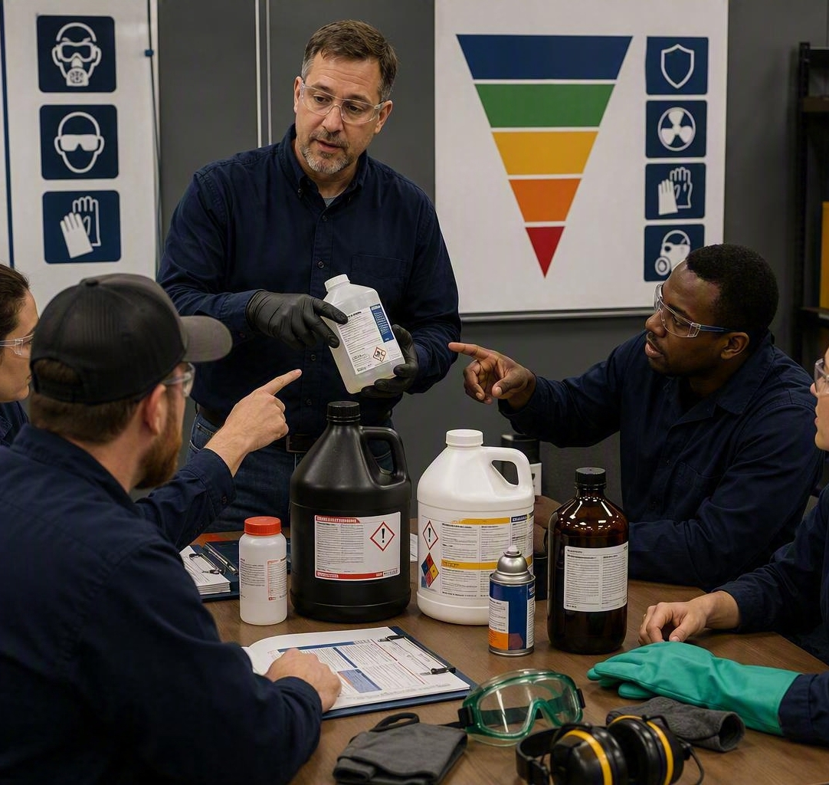
Ventilation
Capture the contaminant before it reaches the breathing zone
A fan that moves air is not automatically effective control.
Source • capture position • airflow • discharge • maintenance
Verify that the system controls the real task, not just the room.
Notes:
Ventilation is an important topic where chemicals are concerned. We don’t have time to get into the details of ventilation in this class but the basic concept is positioning your ventilation so that it captures the contaminant before it reaches the breathing zone of the worker. If you are using positive pressure ventilation you have to ensure your source air is clean. If you are using negative pressure ventilation you have to ensure your air discharge doesn’t cause additional hazards. Flow rates will be situational but getting your flow rates set and a good maintenance program for your ventilation are the last steps in setting up “more than a fan” to protect your workers from expected chemical interactions.

Slide 15
PPE
Match the equipment to the chemical, route and task
“Wear gloves” is not a complete decision.
Which chemical?
What concentration?
Splash or immersion?
How long?
Which route of exposure?
How will it be removed?
Notes:
PPE with chemicals is more than just putting on a pair of rubber gloves when interacting with the substance. You have to match your PPE to your chemical risks and that includes the concentration of the chemical, how long the exposure will continue, what the route of exposure is, and the type of risks (splash vs immersion) your workers will have present during the task. Reading the Sds will explain the level of chemical protective gear that is required/ recommended for the interaction with the chemical but it may require suits, aprons, face shields, or even respirators depending on the specifics of the task.

Slide 16
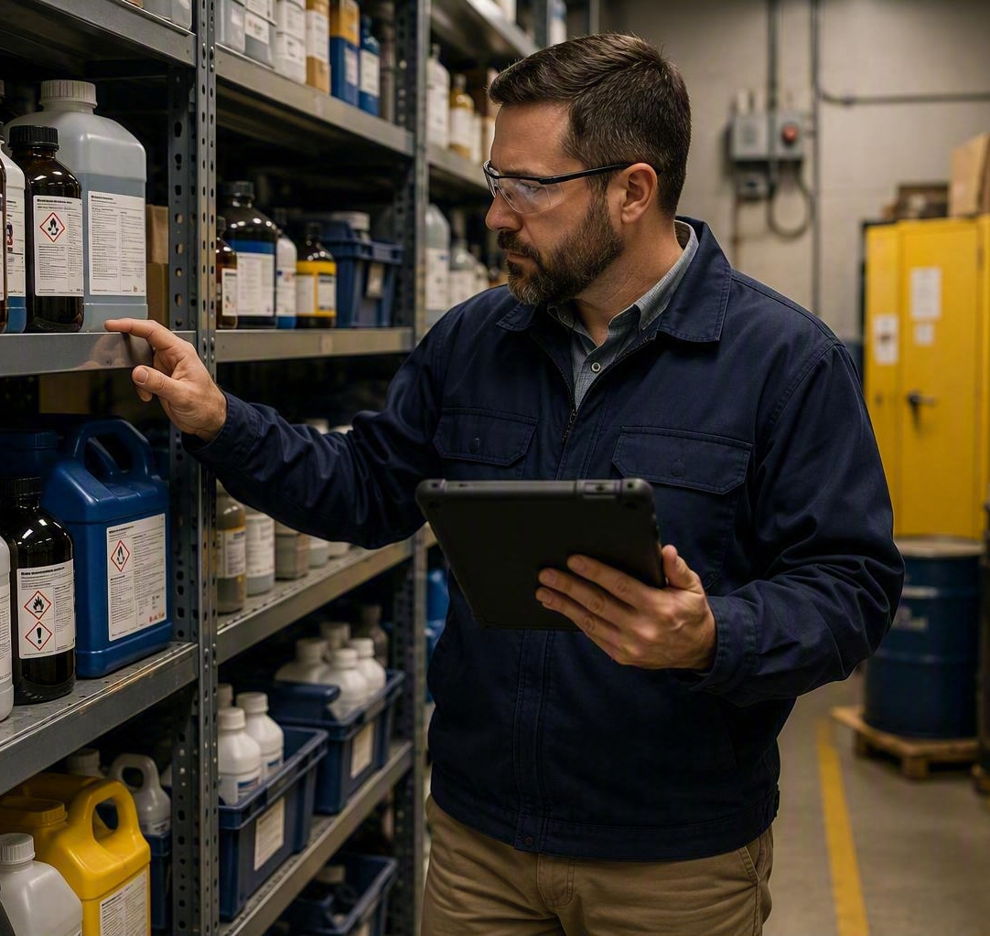
Spill Preparedness
Decide before the container fails
Who can clean it up, with what equipment, and where is the limit?
Recognize
Isolate
Notify
Protect
Contain only within training and capability
Notes:
Spill response is something that should definitely be covered in your emergency training if you have a hazardous chemical inventory. There are special training requirements that go into hazardous materials spill responses, but maintaining a basic spill response procedure is a best practice. It should include:
How to recognize what has spilled and the importance of knowing what chemical youre working with
How to isolate the spill and mark it off so no one gets exposed
How to report the spill and who to report the spill to
How to protect workers that are cleaning up the spill
Knowing what chemicals can and can’t be responded to for spill response with the level of training provided to your workers

Slide 17

Contractor Communication
Two employers can share one work area and still have different information
Before work starts, exchange information about hazards, access and precautions.
Chemicals the host brings
Chemicals the contractor brings
SDS access
Labeling methods
Precautionary measures
Notes:
Interacting with contractors on chemical safety is a lot like running a good chemical safety program its all about information flow. In chemical safety that means having good labeling practices and an easy to use chemical inventory of SDS sheets. In working with contractors its about knowing what chemicals are coming into the workplace that normally aren’t there and ensuring the contractor knows what chemicals are in the workplace they are coming to. SDS sharing is the most effective way to communicate these items, so sharing the SDS’s from each party with the other goes a long way in answering the appropriate questions. You also have to review your labeling requirements and any site specific precautionary measures you use for chemicals. The contractor should understand the rules and expectations of the site and you should understand the chemical hazards that will be coming on site with the contractor. Looking for incompatible chemicals is a major focus of this exchange of information.

Slide 18
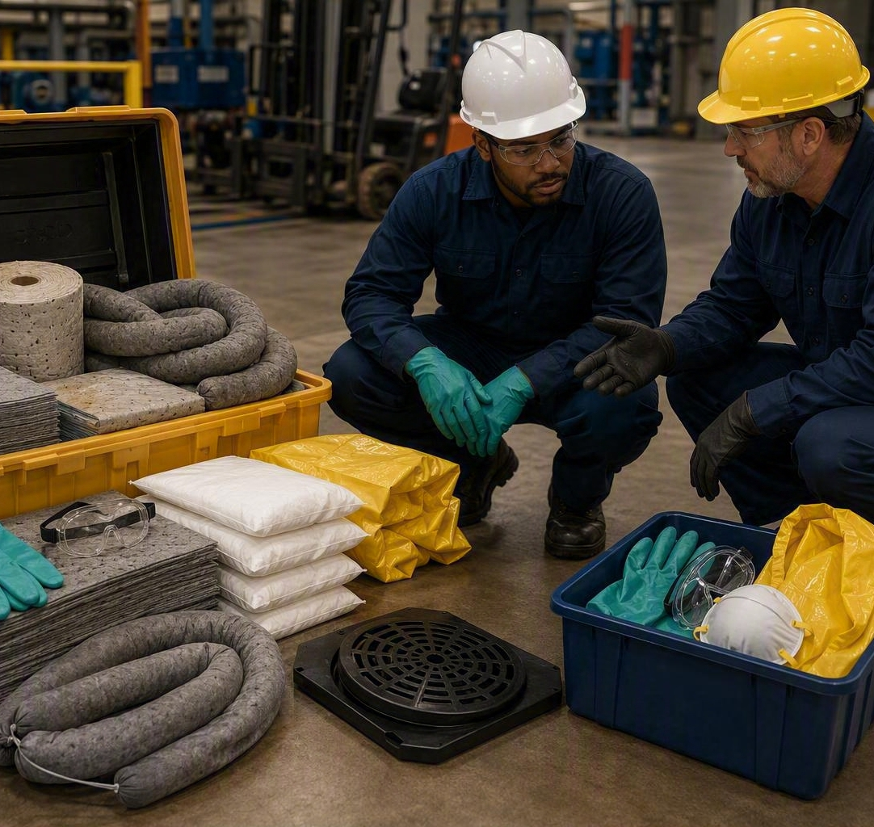
Purchasing Is the Front Door
The cheapest chemical to control is the one you never bring in
Evaluate the product before the purchase order creates an exposure problem.
Is it necessary?
Is a safer alternative available?
Do we have the SDS?
Can we store and use it safely?
What controls, training and disposal will it require?
Notes:
An often overlooked control that can help keep chemical risks in check is “manning the front door” of the workplace. If you put purchasing controls in place for hazardous substances before the purchase is made you have better control over what is in the workplace. This allows you to know what is in your inventory, control for incompatible chemicals before they are purchased, ensure there aren’t safer alternatives available. A simple process where the SDS is reviewed before purchasing is authorized with a sign off form can go a long way.

Slide 19
When Chemicals Change, the System Must Change
REVIEW
APPROVE
RECEIVE
LABEL &
STORE
TRAIN
VERIFY
A new product can change the inventory, SDS access, storage, controls, emergency planning and training.
Notes:
Another important reason for a pre-purchase review of new chemicals is it keeps you from upsetting your program with each new chemical purchase. There is a cycle to the program that includes planning for storage, training for use, making information available about the chemical that can be disrupted when new chemicals come on site before the program is ready for them. When you look at all the work put into creating and maintaining a chemical inventory, an SDS library, appropriate training for the chemicals in use it makes it apparent that having controls in place to protect all that effort is a good business decision.

Slide 20
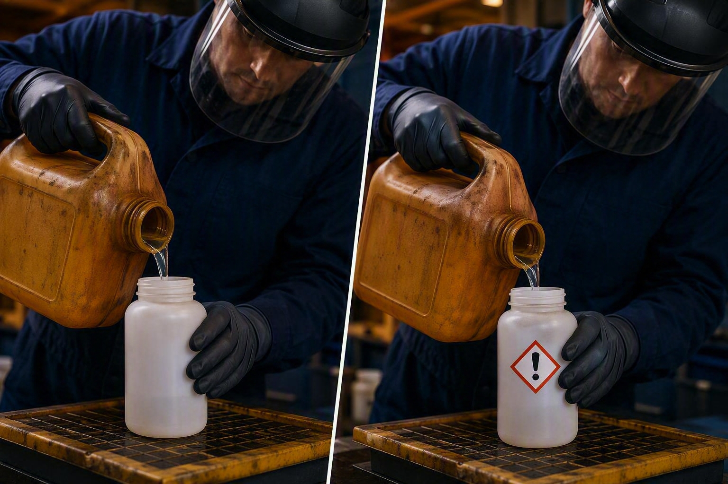
Test the Program Where the Work Happens
Pick one chemical. Follow it from purchase to use.
Is it on the inventory?
Does the container match the SDS?
Can the user explain the hazards?
Are the controls present and working?
Notes:
A quick way to get a feel for how well your chemical safety program is working is to pick a chemical and follow it through the process.
Is the chemical in our inventory?
Does the container label match the SDS sheet?
Do we have training for the handling, use, or storage of the chemical?
Can the user explain the hazards of the chemical or where they would find them?
Can the user explain the proper way to handle or use the chemical?
Are the engineering controls functioning properly such as ventilation in the area?
If you follow the chemical through the process and find that we have the SDS, its on the inventory, its labeled properly, stored properly, Employees understand its hazards and proper use, and all our controls are in good condition and operating then we can imply that our chemical safety program is working effectively.

Slide 21
From Binder to Management System
DOCUMENTS
ACCESS
DECISIONS
Inventory exists
SDSs collected
Program written
Labels readable
SDSs reachable
Training delivered
Purchasing controlled
Controls verified
Changes managed
Compliance is the floor. Reliable decisions are the outcome.
Notes:
So really it becomes easy to see that hazard communication is more than an SDS binder in the tool crib. To be truly effective we have to have other items in place as well
Hazcom Program that explains our processes and controls to employees
SDS library that represents the entire chemical inventory is accessible and functional for employees
Labels in use on all secondary containers and have the correct information on them
Training exists that explains the hazcom program and any site specific chemical safety information employees would need

Slide 22
TOMORROW MORNING...
✓
Can employees locate an SDS quickly?
✓
Are secondary containers labeled?
✓
Does the inventory match reality?
✓
Are flammables and oxidizers stored correctly?
✓
Do contractors understand chemical hazards?
✓
Are new chemicals evaluated before purchase?
✓
Is training updated when chemicals change?
Hazard Communication helps people make good decisions before they are exposed.
Notes:
I leave you with these parting thoughts- Tomorrow when you arrive at work ask yourself these 7 questions to evaluate your chemical safety program. Do employees really know how to find information on the chemicals in the workplace? Is the inventory accurate based on what is on site? Do we interact and share enough information with our contractors? Is our training current to our chemical inventory? Are our secondary containers labeled? Do we segregate incompatible chemicals like flammables from oxidizers? And finally- are we reviewing new chemicals before they are purchased?
These questions can quickly give you a high level feel for how effective your hazcom / chemical safety program really is.

